Slide 1
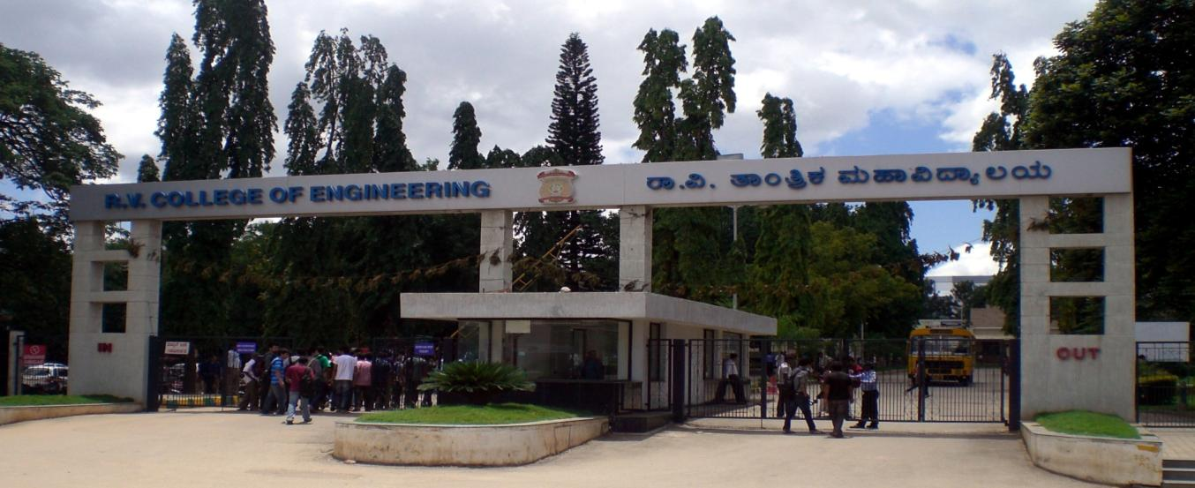
VIII Semester Major Project Work
Department of Computer Science,
R V College of Engineering, Bengaluru

Slide 2
CCTV Video Summarization in Urban Environments
A.S. Karthik 1RV15CS001
Abhishek Krishna 1RV15CS007
Gagan Deep G 1RV15CS053
Internal Guide : Dr Ramakanth Kumar P (Professor and HoD CSE)

Slide 3
Agenda
Identification of Problem in the program Domain and Detailed Analysis
Study of the Existing Systems and Feasibility of Project Proposal
Literature Review
Research gap
Objectives
Methodology
High Level Design
Low level Design
Implementation
Experimental Results & Analysis
Conclusion & Future Work
Demonstration of the project

Slide 4
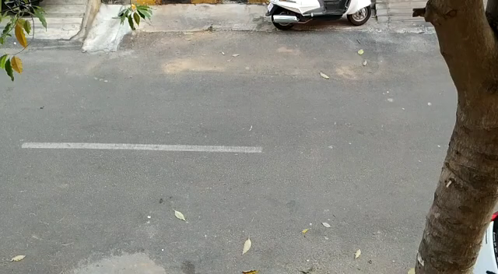
Initial Concept – Input Video

Slide 5
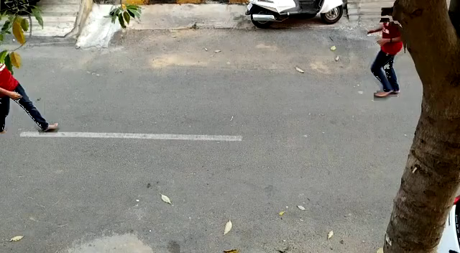
Initial Concept – Output Video

Slide 6
Identification of Problem in the program Domain and Detailed Analysis
Large amounts of CCTV footage are generated every hour
Millions of surveillance cameras are in use across the country
Footage is mostly sparsely distributed with events
Manual analysis of footage is laborious and time consuming
There is need for smart tools to generate useful insights and summaries

Slide 7
Study of the Existing Systems and Feasibility of Project Proposal
Fast-Forwarding
Primitive
Chances of losing information
Difficulty in analysis
Motion detection and concatenation
Room for further shortening the summary
Overlapping optical flows in time dimension
NP hard problem
Existing systems are proprietary

Slide 8
Literature Review
Year, Name of the Journal/Conference | Title of the paper | Authors of the paper | Model/Sub Model used | Challenges of the paper | Limitations of the paper
AAAI Conference on Artificial Intelligence. 2018. | Deep Reinforcement Learning for Unsupervised Video Summarization | Zhou, Kaiyang, Yu Qiao, and Tao Xiang. | LSTM | End to end summarization of movies | Computationally expensive, Not suitable for CCTV video footage
Computer Vision and Pattern Recognition, 2006 | Making a Long Video Short: Dynamic Video Synopsis | Rav-Acha, Alex, Yael Pritch, and Shmuel Peleg. | Motion detection-based synopsis | Methodology for rearrangement of video clips in time | Not based on any queries other than time
ICCV 2007. IEEE 11th International Conference on. IEEE, 2007. | Webcam Synopsis: Peeking Around the World | Pritch, Yael, et al. | 2 phase approach to summarization | Object queue to deal with limited storage space | No smart querying based on objects

Slide 9
Literature Review
Year, Name of the Journal/Conference | Title of the paper | Authors of the paper | Model/Sub Model used | Challenges of the paper | Limitations of the paper
IEEE Transactions on Pattern Analysis & Machine Intelligence 11 (2008) | Non-Chronological Video Synopsis and Indexing | Pritch, Yael, Alex Rav-Acha, and Shmuel Peleg. | Storage of original video frames along with extracted tubes | Method for indexing the summary video to link back to the original video | No smart querying based on objects
Computer Vision and Pattern Recognition (CVPR), 2016 IEEE | You Only Look Once, Unified Real-time object Detection | Joseph Redman, Santhosh Divvala, Ross Girshick, Ali Farhadi | YOLO 24 layered CNN | Real-time object detection and localisation | Lesser accuracy compared to other standard models.
ELSEVIER Pattern Recognition Letters, 2014 | Efficient adaptive density estimation per image pixel for the task of background subtraction | Zoran Zivkovic, Ferdinand van der Heijden | MOG2 | Pixel by pixel dynamic selection of number of Guassians | Susceptibility to noise, computationally expensive.

Slide 10
Literature Review
Year, Name of the Journal/Conference | Title of the paper | Authors of the paper | Model/Sub Model used | Challenges of the paper | Limitations of the paper
Computer Vision and Pattern Recognition (CVPR), 2010 IEEE | CRAM: Compact Representation of Action in Movies | Mikel Rodriguez | Clifford Fourier Transform | Can detect specific actions | Doesn’t keep all events in the final summary
Advanced Video and Signal Based Surveillance. IEEE, 2009. | Clustered synopsis of Surveillance Video | Pritch, Yael, et al. | Similarity based clustering | Determining the extent of similarity between different events. | Unable to clearly differentiate between events having high similarity.
IEEE, 2003. | A Shortest Path Representation for Video Summarization | Porter, Sarah V., Majid Mirmehdi, and Barry T. Thomas. | Graph cuts | Creates panoramic summaries | It is static, produces images

Slide 11
Research gap
There is no method to generate summaries based on the objects or properties of the objects in the video (Smart synopsis based on tags)
Lack of clear optimization techniques for rearrangement of spatio-temporal object tubes.

Slide 12
Objectives
Develop a novel CCTV video summarization technique
Experiment with different techniques to efficiently overlap events for creating the summary
Develop a smart method to query a video
Develop a simple GUI

Slide 13
Methodology
We perform the video summarization in 2 phases.
Phase 1 – Real-time phase
This phase takes place when the camera footage is being recorded.
The footage is processed and stored so that it can be accessed easily and be used for the 2nd phase
Phase 2 – Query phase
The summary is generated based on a user query
The data stored in phase 1 is retrieved and used for generating the final summary

Slide 14
Methodology – Phase 1
Background Masking
Object Tubes computation and extraction
Motion Detection
Object Detection and tagging
Footage and metadata storage

Slide 15
Methodology – Phase 2
Tube Rearrangement
Blending tubes and background to create summary
Selection of tubes based on user query
Time-lapse background generation

Slide 16
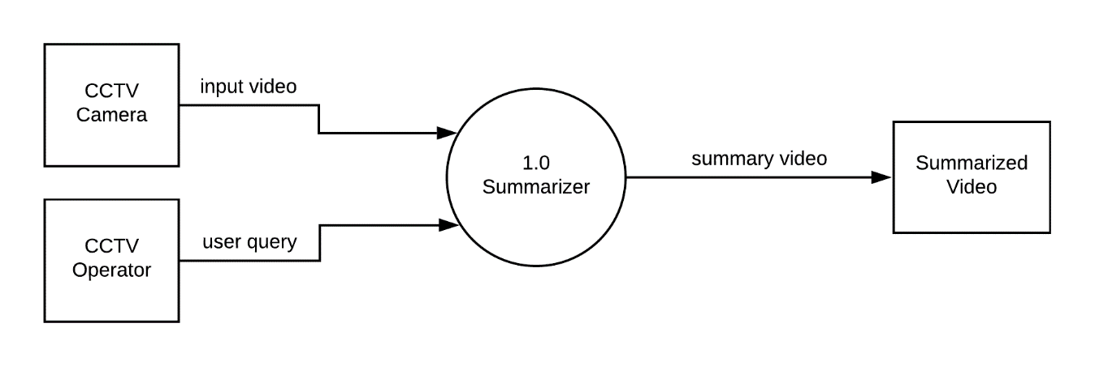
High Level Design (DFD)
Level-0

Slide 17
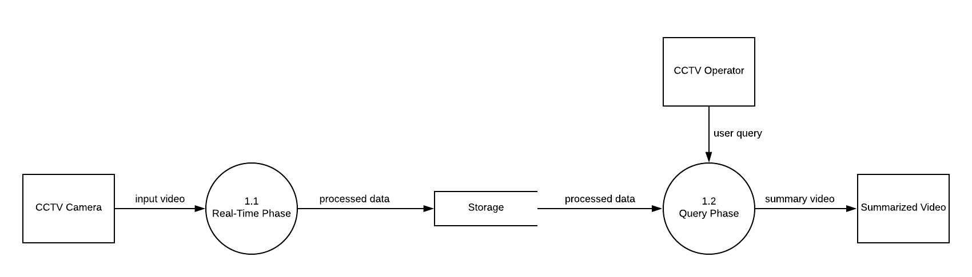
Level-1

Slide 18
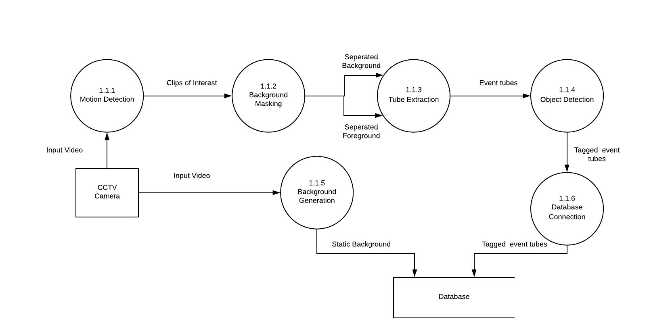
Level-2 (Real-Time Phase)

Slide 19
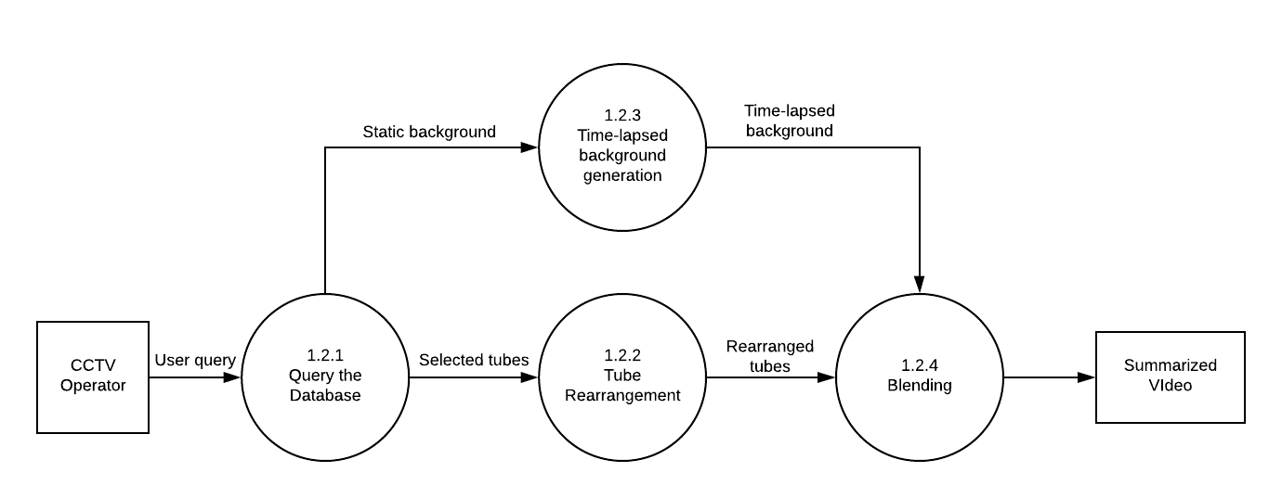
Level-2 (Query Phase)

Slide 20
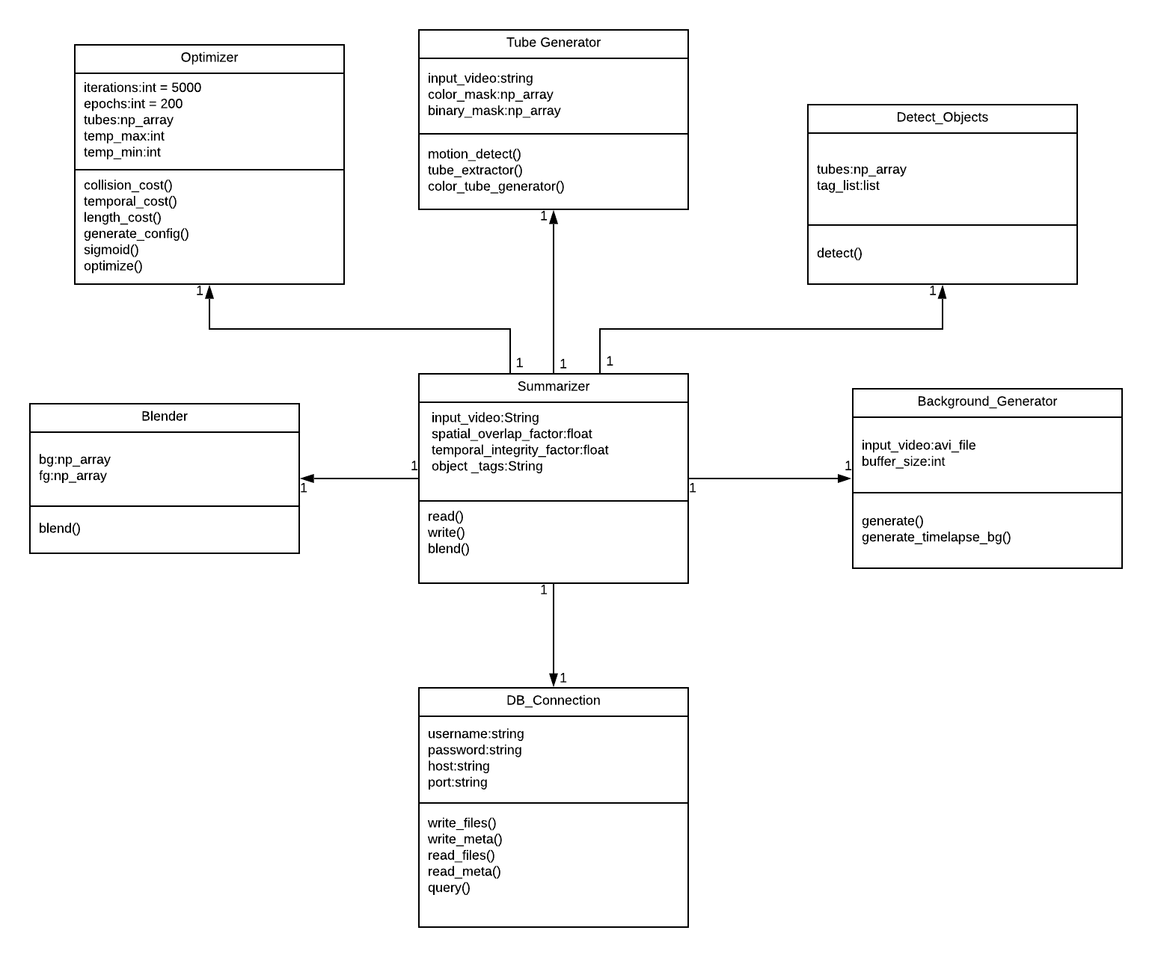
Low Level (Modules)

Slide 21
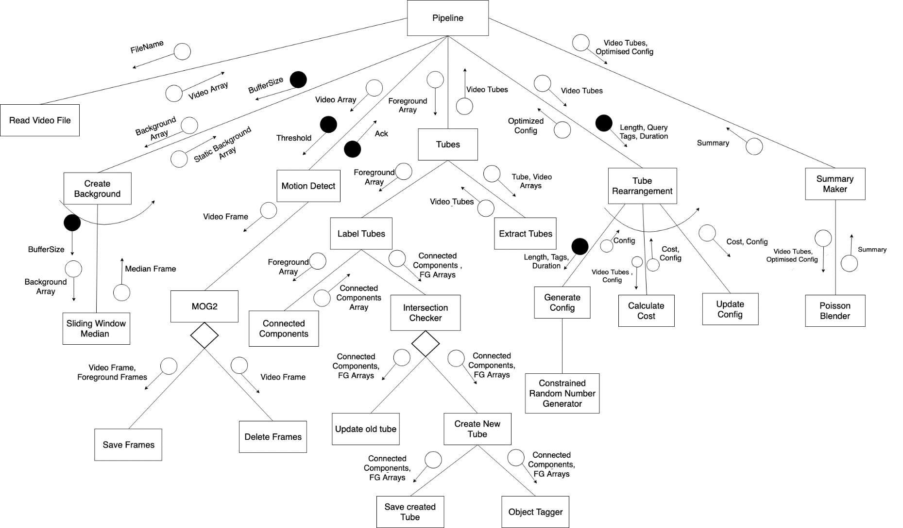
Low Level (Structure Chart)

Slide 22

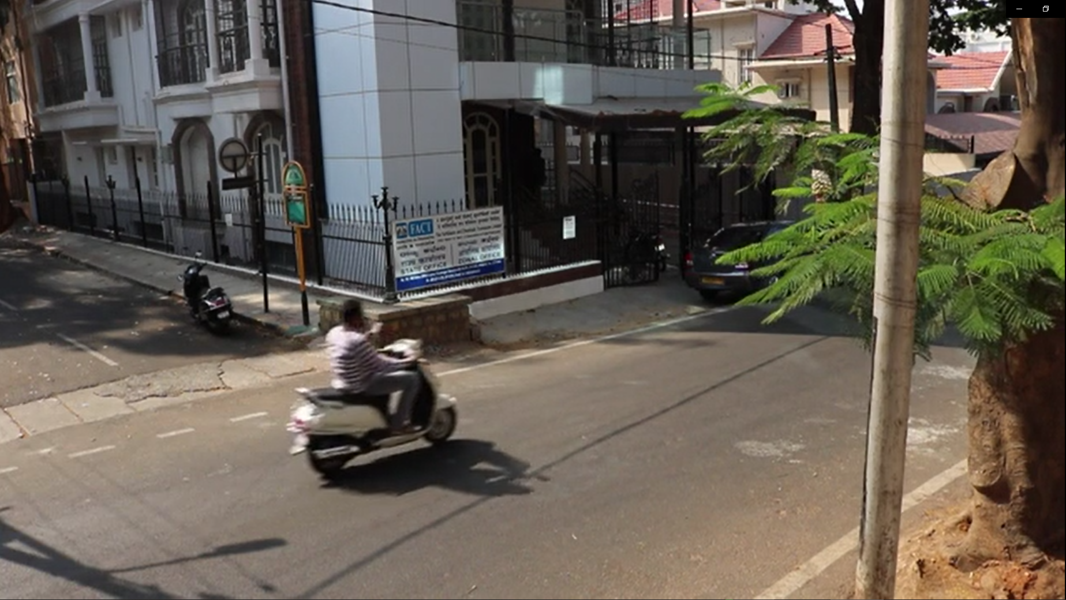
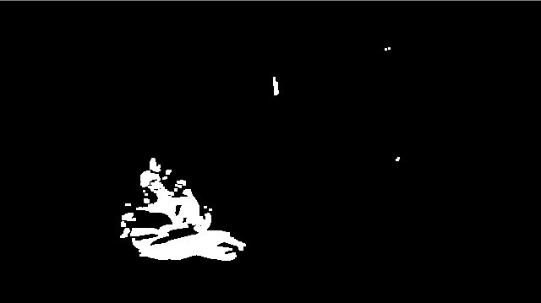
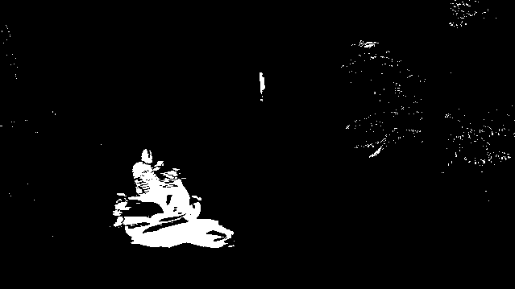


Motion detection and masking
Implementation

Slide 23
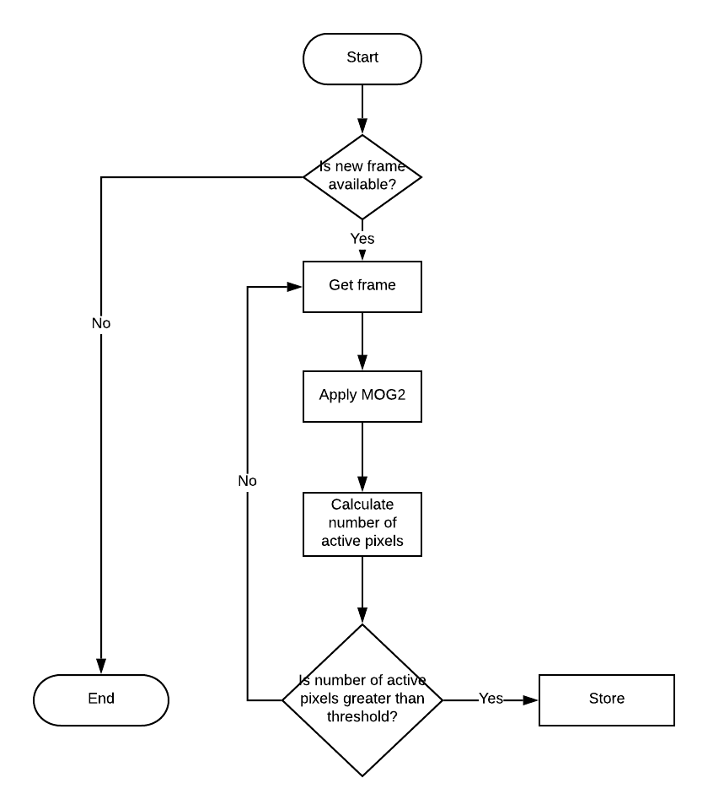
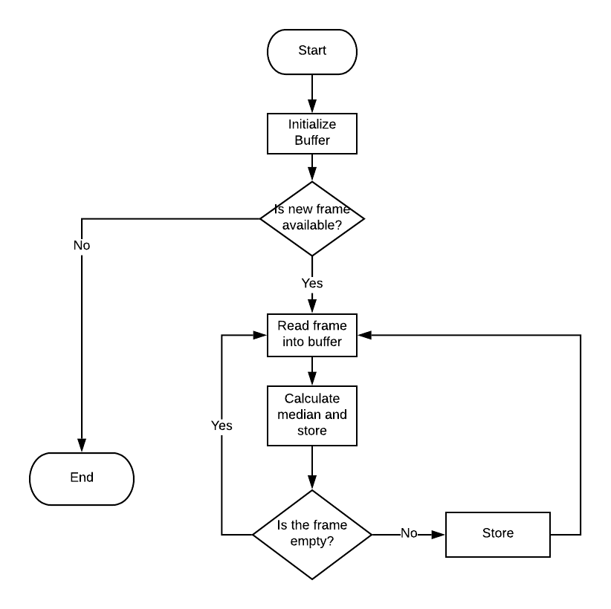
Implementation Flowcharts
Background Creation
Motion Detect

Slide 24
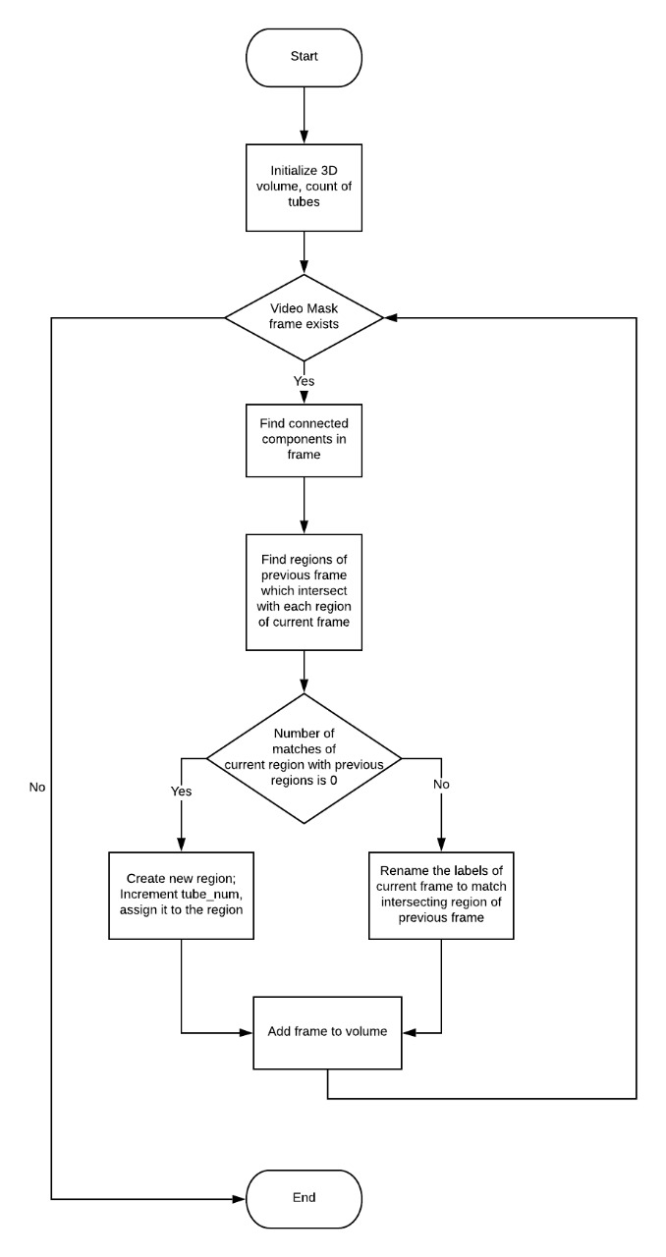
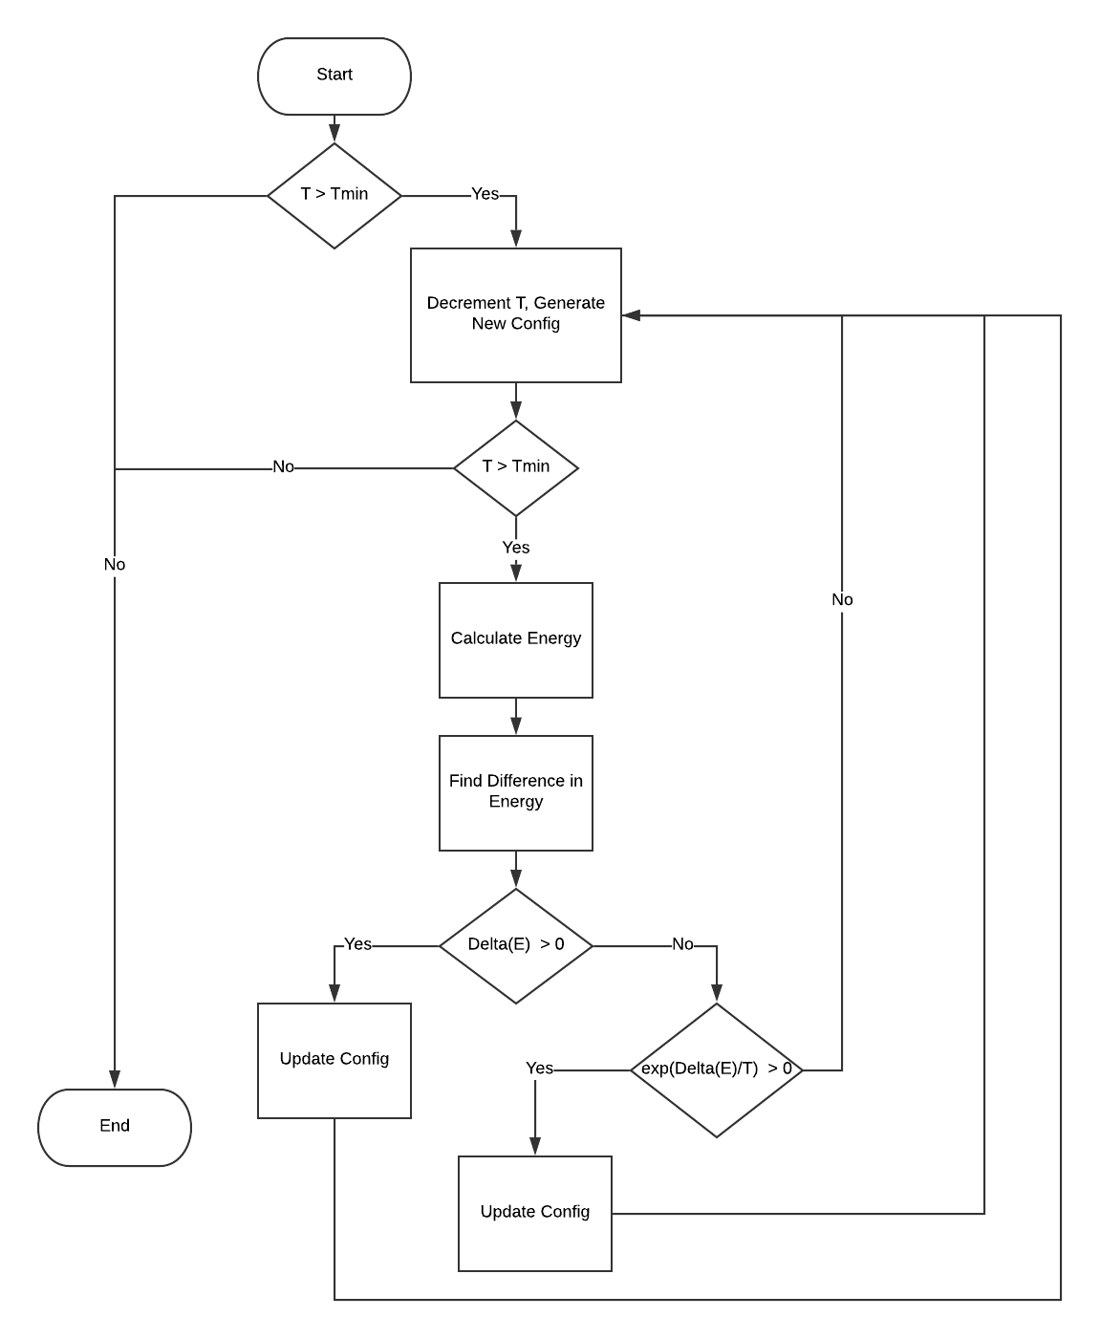
Tube Extraction
Simulated Annealing

Slide 25
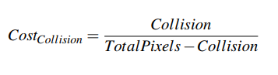
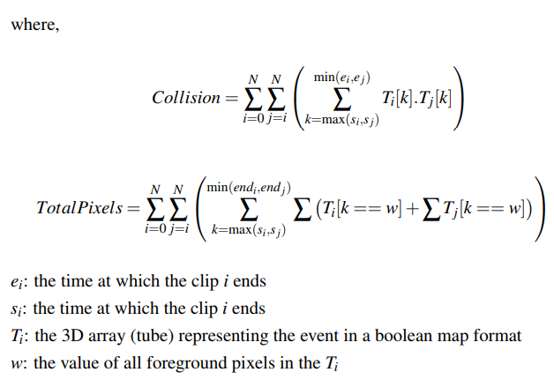
Cost Functions

Slide 26
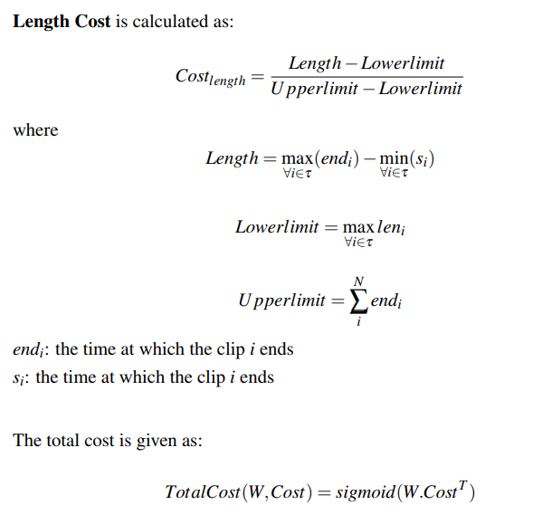
Cost Functions

Slide 27
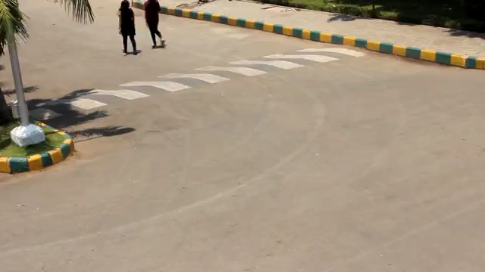
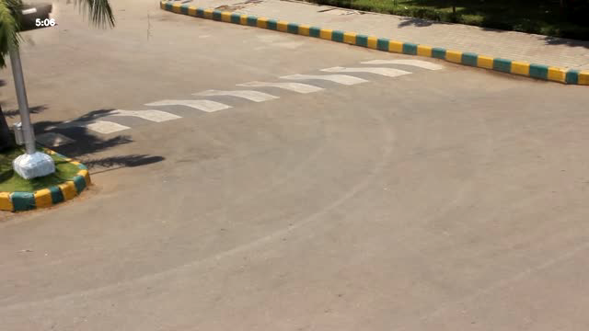
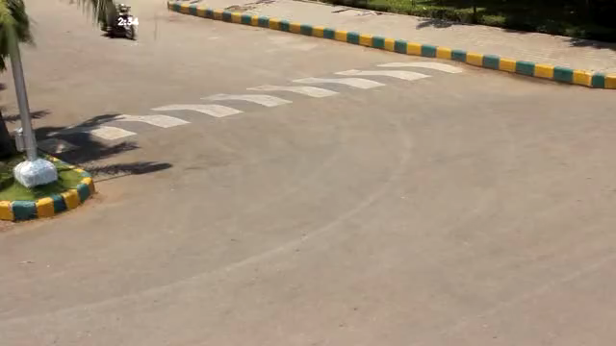
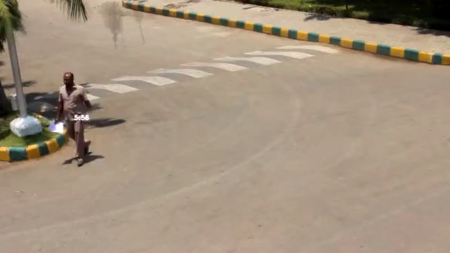
Experimental Analysis
Input video (8 min)
Summary - Car (12 sec)
Summary - Bike (18 sec)
Summary - All (1 min 45 sec)

Slide 28
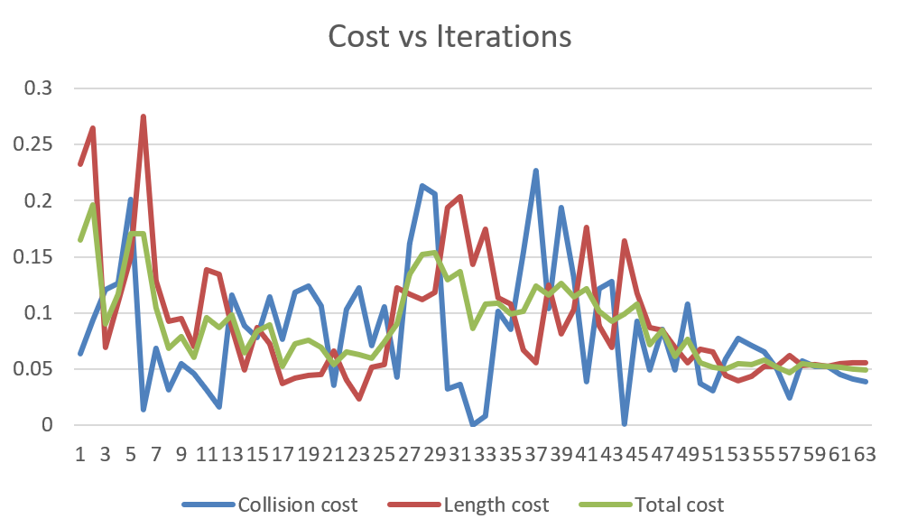
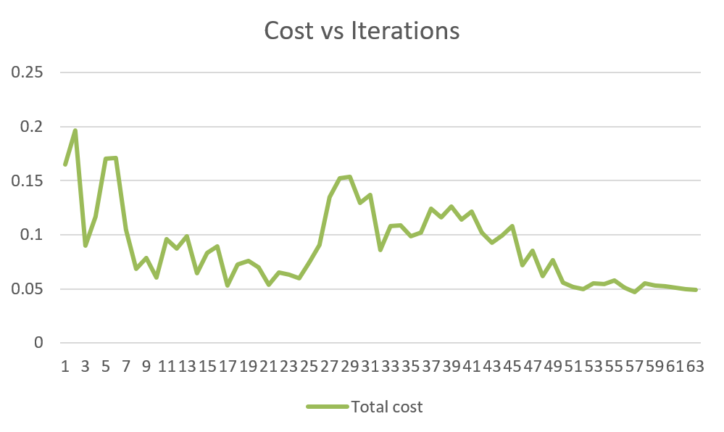
Experimental Analysis

Slide 29
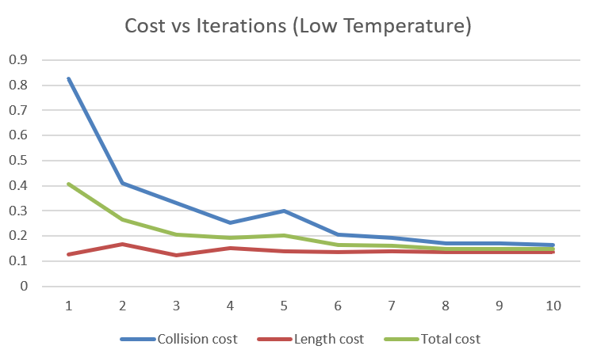
Experimental Analysis

Slide 30
Experimental Results & Analysis
Video length is reduced by 4-6x compared to the original

Slide 31
Experimental Results & Analysis
Dataset
Video clips with sparse activity, recorded in college and quiet urban environments
Performance
Realtime phase: Runs in real-time (30fps) on recommended hardware
Query phase: ~1 min for generating a summary with 10 events

Slide 32
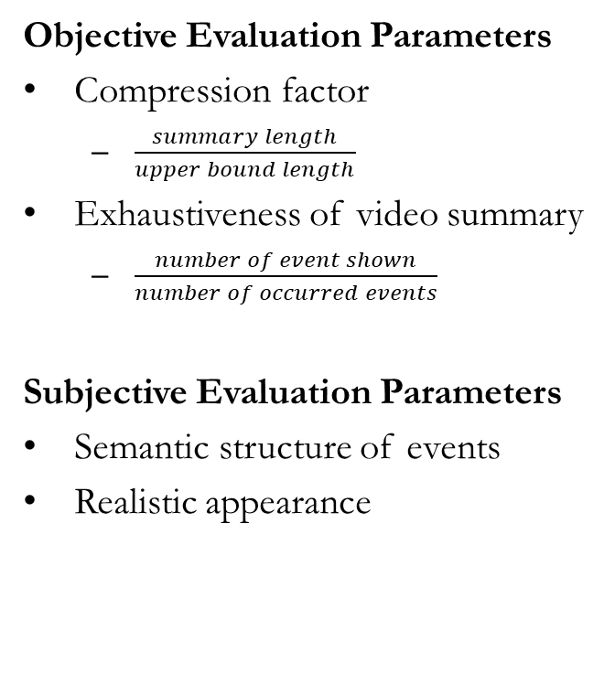
Experimental Results & Analysis
Objective Evaluation Parameters
Compression factor
$\frac{summary length}{upper bound length}$
Exhaustiveness of video summary
$\frac{number of event shown}{number of occurred events}$
Subjective Evaluation Parameters
Semantic structure of events
Realistic appearance
Compression Factor
Compression factor: ~40% improvement from baseline event length
Exhaustiveness
~90% detection rate of events (people, bikes, cars)
Semantic Structure
Interacting events are shown together in most cases
Realistic Appearance
Almost realistic, blending can be improved

Slide 33
Demonstration of the project

Slide 34
Conclusion & Future Work
We have developed a novel method to generate compressed video summaries using current state-of-the-art algorithms (YOLO, Dynamic MOG)
We have successfully shown a proof of concept for a product with huge potential
While the current implementation requires high-end processors and lot of memory to generate summaries, there is still a large scope for parallelisation and for improving the efficiency
We plan to optimise and perform intensive testing to identify complicated semantic structures and properly deal with them.
Further improvement in blending of events into the background

Slide 35
Thank You

